Slide 1

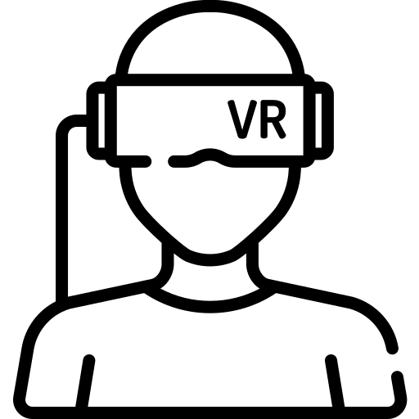
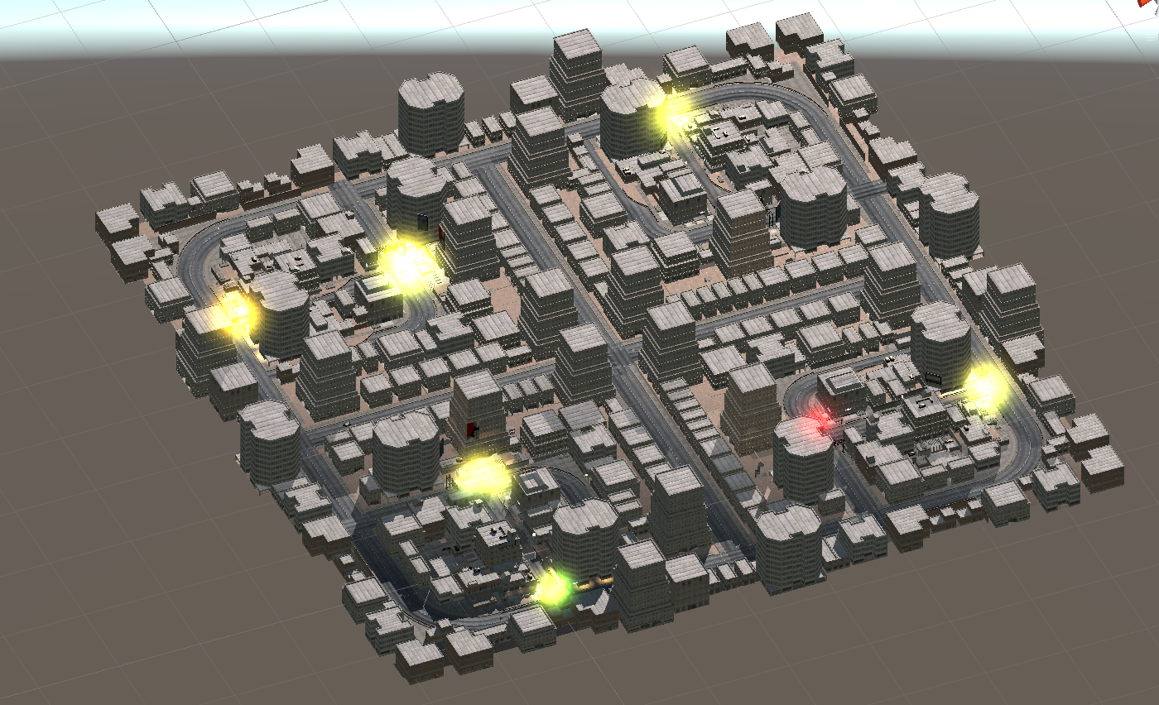
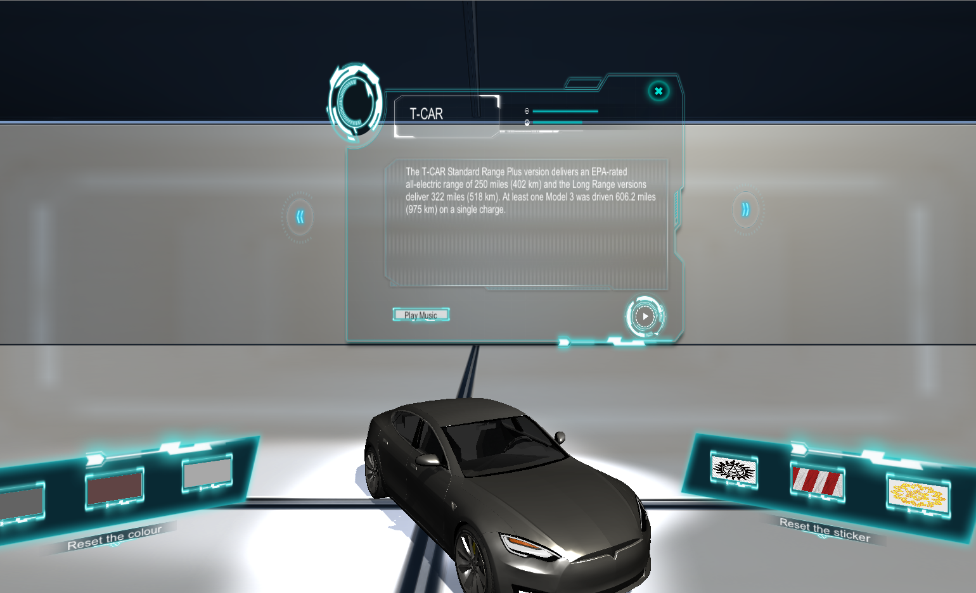
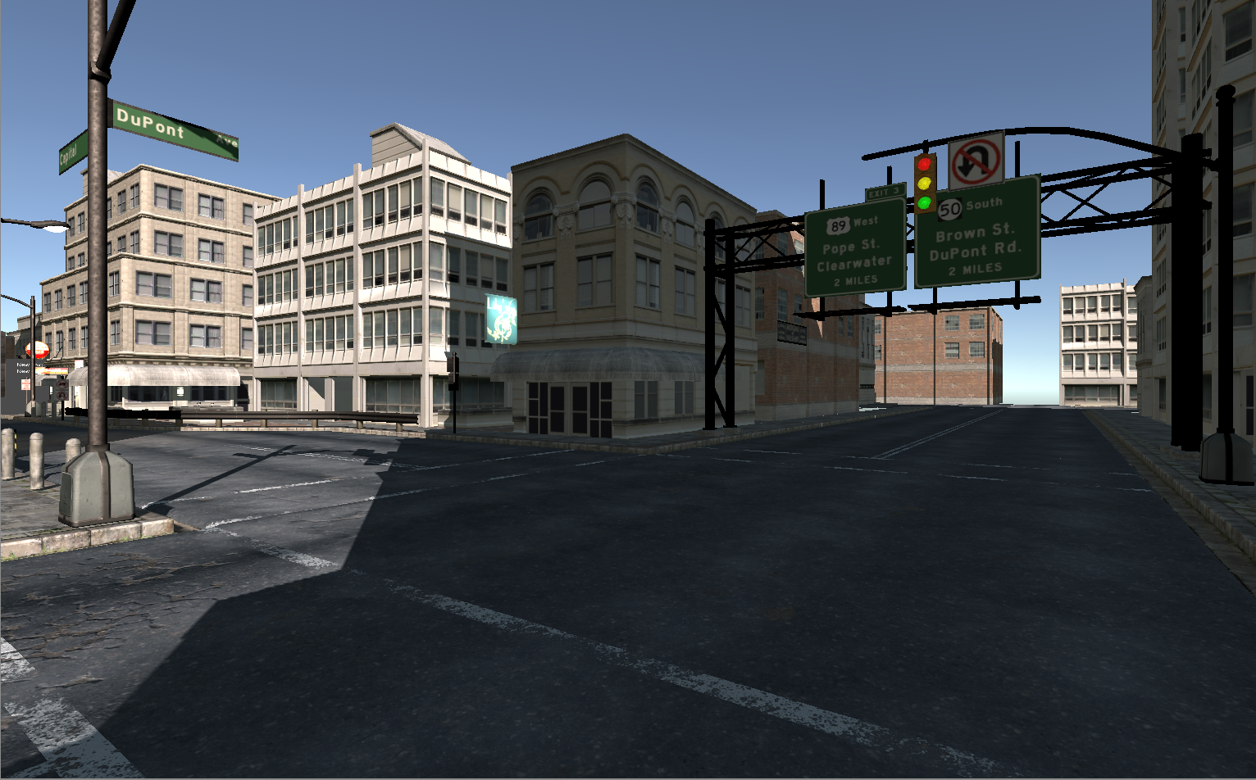

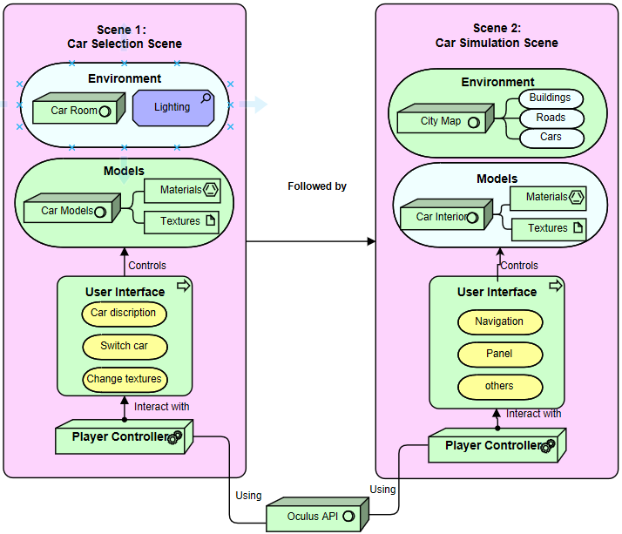

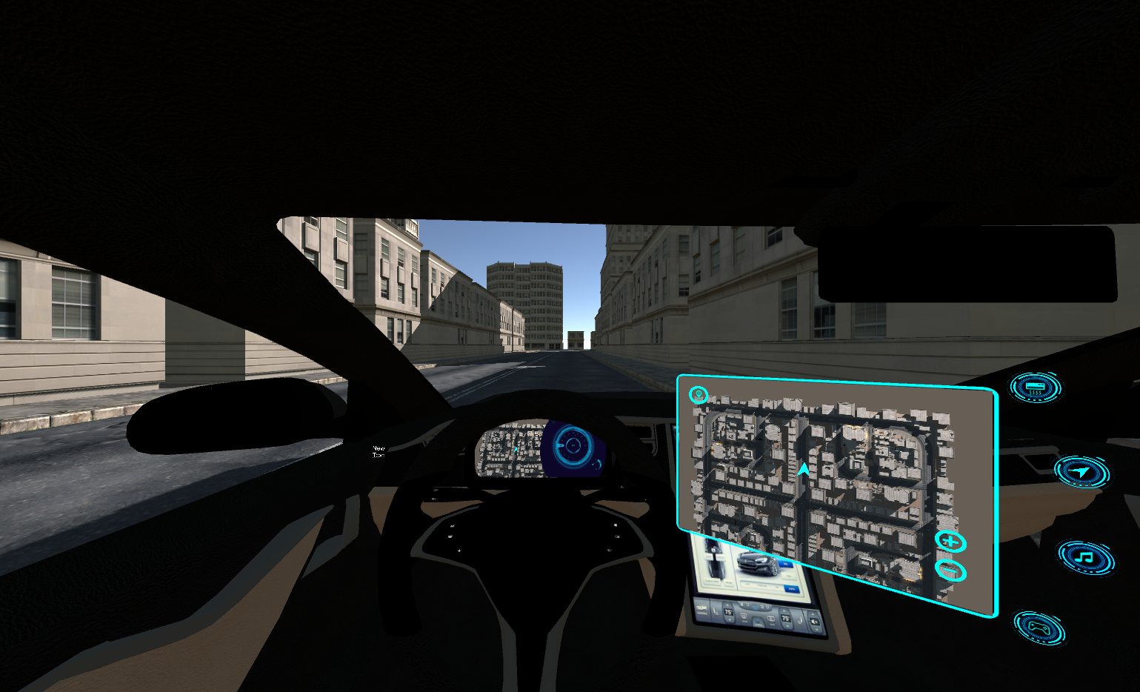

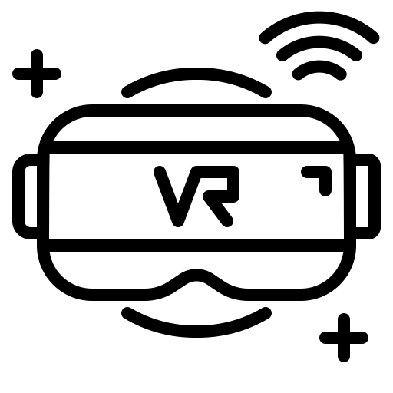



COMP0016
POSTER NUMBER
RESEARCH POSTER TEMPLATE TITLE
System Engineering
Team 25
Autónomo
^{YOUR NAME SURNAME}
^{SUPERVISOR NAME SURNAME}
^{YOUR DEPARTMENT}
Xuyou Cheng | Yifan Zhang | Abir Bhushan
Abstract
What do you have to do when you have to buy a car?
About 30 years ago, this meant visiting multiple dealerships kicking tyres, driving around the block and comparing price, styling and comfort. Then came the internet, allowing people to compare vehicles online before visiting a smaller number of dealers.
Now, thanks to Virtual Reality it is possible several cars without actually seeing any of them. And with our clients, NTT Data, we endeavoured to understand just that - the car-buying experience of the future - by simulating the experience of riding in a fully autonomous (Level-5) self-driving car using VR and Hand Tracking. The use of VR and Hand Tracking creates a very real-world experience of riding in a self-driving car and has lower costs compared to test-rides. Our solution uses an Oculus Quest headset to simulate a feature-complete experience of a Level 5 autonomous car and our application is written using Unity and C#.
Experiece a feature-complete self-driving car simulation in Virtual Reality (VR)
Interact with the virtual world of a fully autonomous (Level-5) car with Hand Tracking and Gestures
System Architecture and Solution
Choose from a range of cars and customise each one as you like
Our solution uses an Oculus Quest headset to simulate a feature-complete experience of a Level 5 autonomous car and our application is written using Unity and C#.
Key Features
Virtual Reality - Get the complete self-driving experience - move around and look around just like in a real-life setting, interact with elements of a fully autonomous (Level-5) car, customise these elements to your preference, understand how the car will always choose the most optimal route, and much more - all in a Virtual Reality (VR) environment.
The Hand Tracking Experience - Interact with the simulation just like you would interact with a real object - choose your destination with a single touch on a map, use Gestures to enter/exit the simulation, to control the entertainment system (system has a music library and a simple game), and to choose and customise your car
.A Feature-Complete Simulation - Choose a car you like, customise its exteriors and interiors, choose a destination, look around a complete city environment (with roads, bridges, buildings, traffic lights, and more), play music, games, and more on the entertainment system, and most importantly, sit back and relax - the car drives on its own! Autónomo emulates and simulates a feature-complete self-driving experience.
Through Oculus Hand Tracking API, users are able to interact with the virtual environment by using touch and gestures.
Key Requirements
Users should be able to customise their riding experience
Create a virtual city world with buildings, bridges, etc.
Design and build cars with interior elements that may be found in (Level-5) cars in the future
Create a user-friendly interface with all essention WIMP elements
Users should be able to use gestures to interact with the VR environment
Write an efficient pathfinding algorithm that navigates the car
Tel: 020 3108 3854 Ext: 53854
Collaborators logos

